Slide 1
What does a project mean?
The project must serve a specific objective.
The project must have a certain life with a beginning and an end.
Generally, the project should be carried out with the coordinated work of several departments and experts.
Typically, the project to be done should be one that has never been done before.
The project needs a budget, exact time, and performance needs.
Source: Paksoy & Deveci (2023)

Slide 2
What are the characteristics of a project?
The project to be done should be different from other projects and be unique.
The project to be done must change a process.
Each project should have a specific objective.
Each project has a specific life with a beginning and an end.
Each project has a budget, duration, and performance conditions.
Source: Paksoy & Deveci (2023)

Slide 3
What is project management?
A project may be defined as a series of related jobs usually directed toward some major output and requiring a significant period of time to perform.
Project management can be defined as planning, directing, and controlling resources (people, equipment, material) to meet the technical, cost, and time constraints of the project.
Source: Jacobs & Chase (2022)

Slide 4
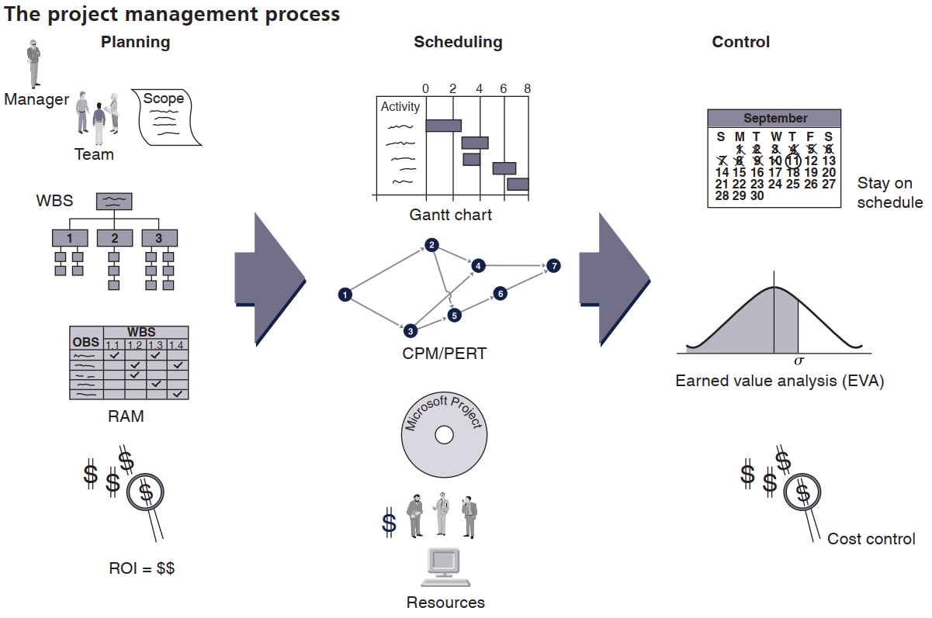
Source: Taylor III (2018)

Slide 5
Project planning
Project scope
Contract requirements
Schedules
Personnel
Objective
Resources
Control
Risk and problem analysis
Source: Taylor III (2018)

Slide 6
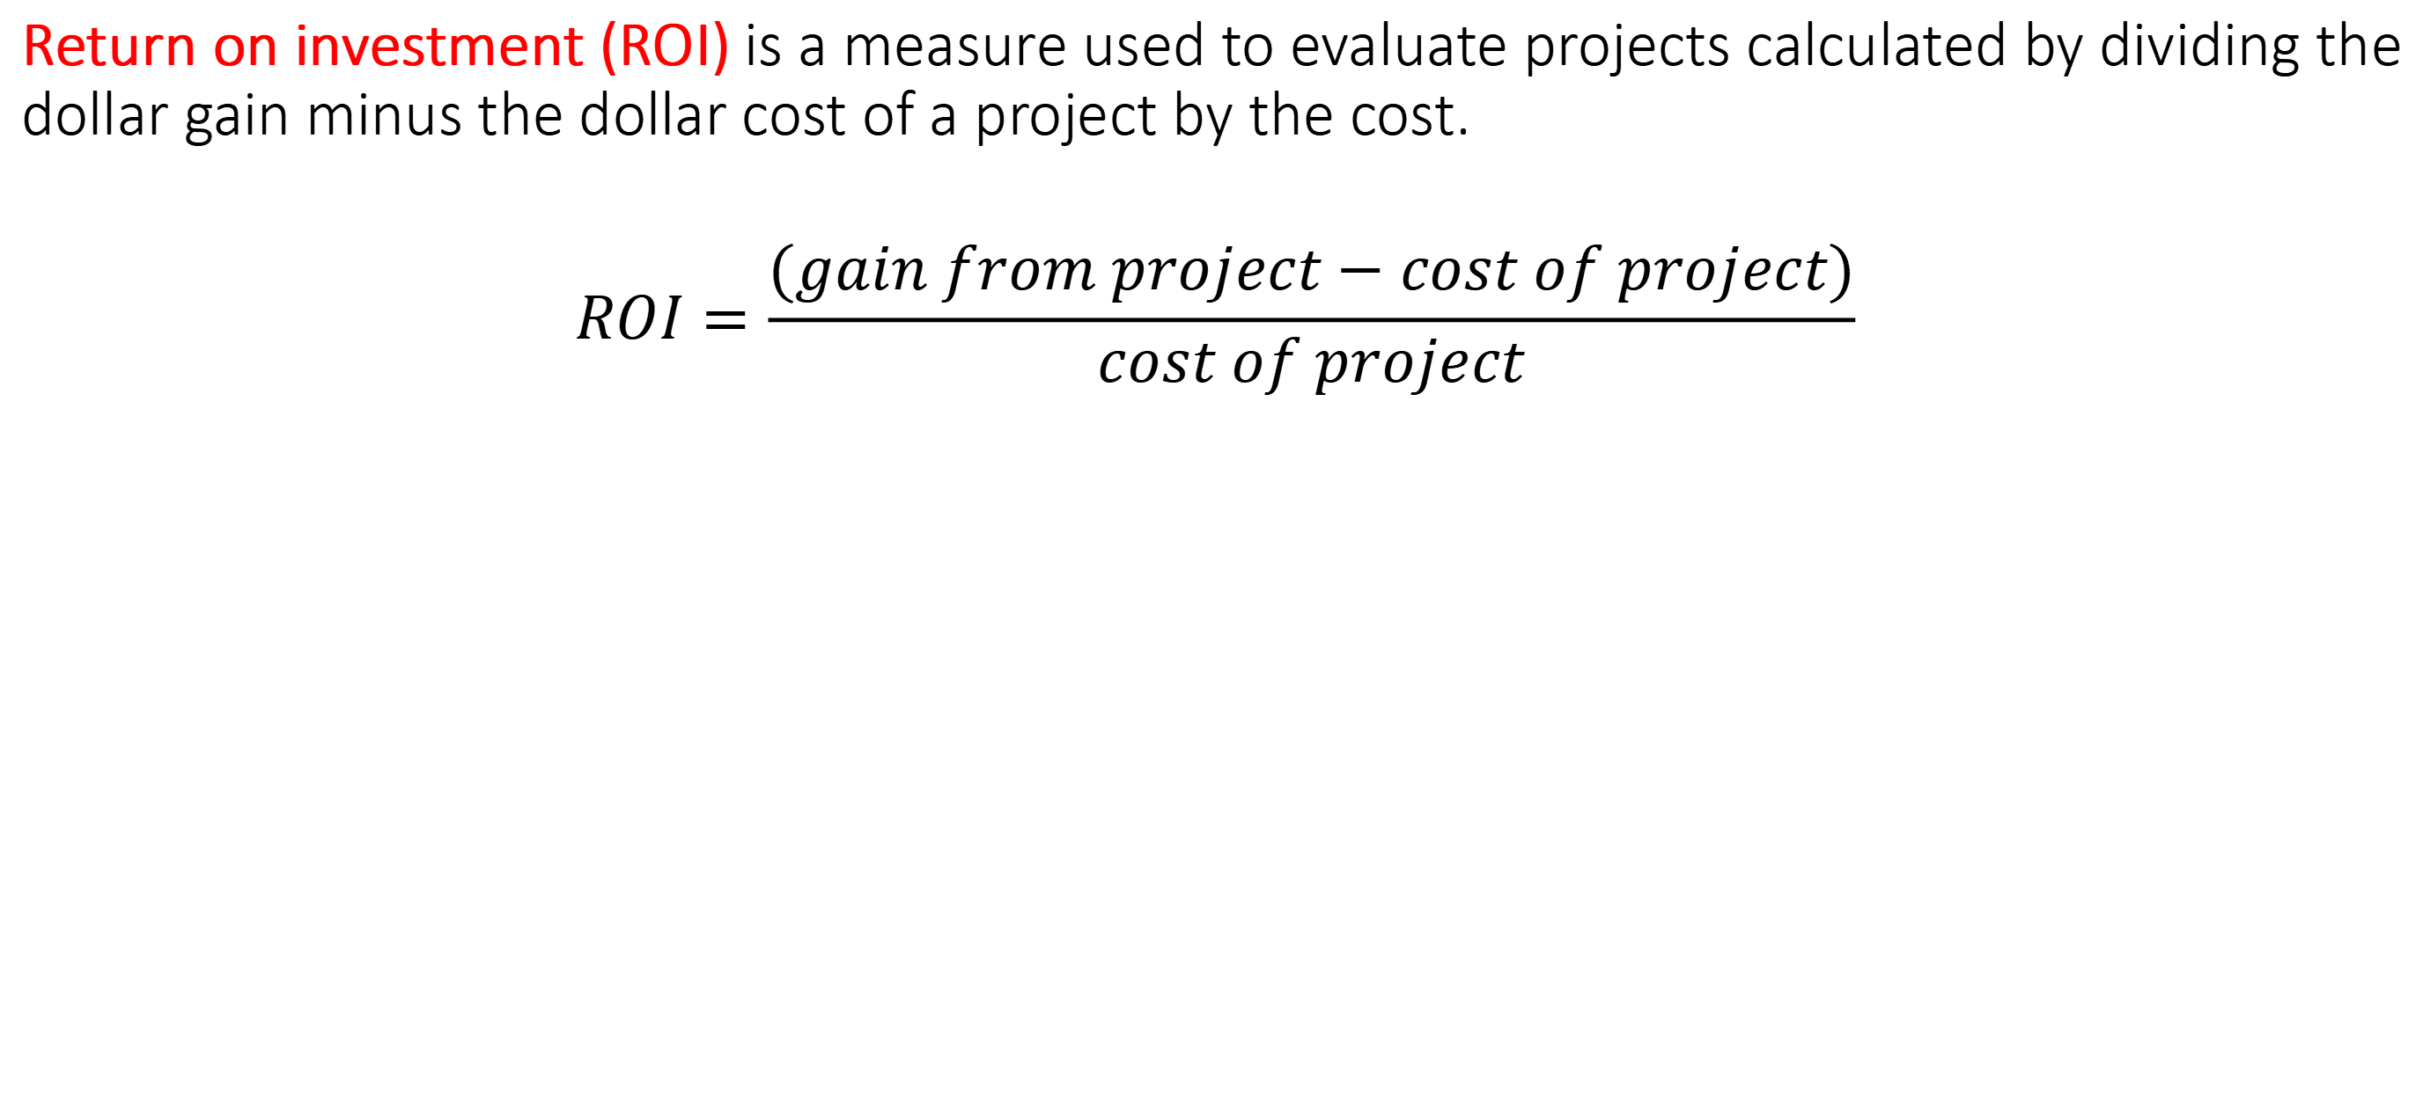
Project return
Return on investment (ROI) is a measure used to evaluate projects calculated by dividing the dollar gain minus the dollar cost of a project by the cost.
$$ROI=\frac{(gain from project−cost of project)}{cost of project}$$
Source: Taylor III (2018)

Slide 7
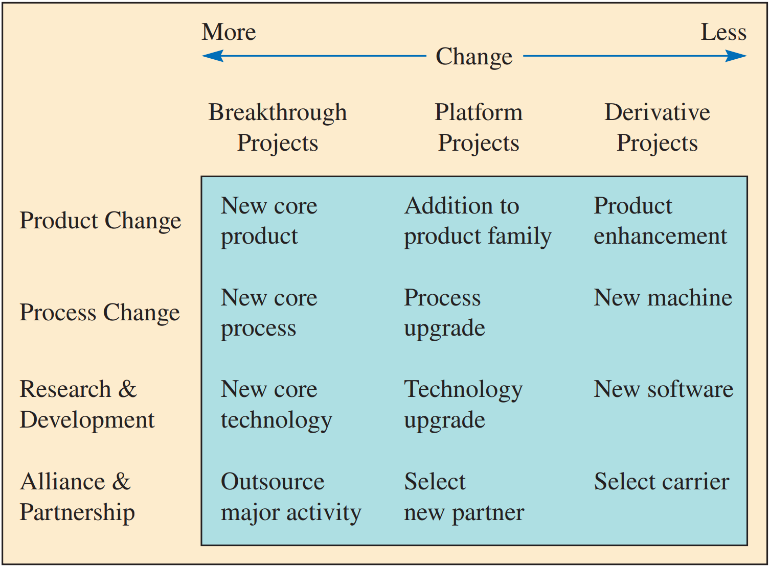
Types of Development Projects
Source: Jacobs & Chase (2022)

Slide 8
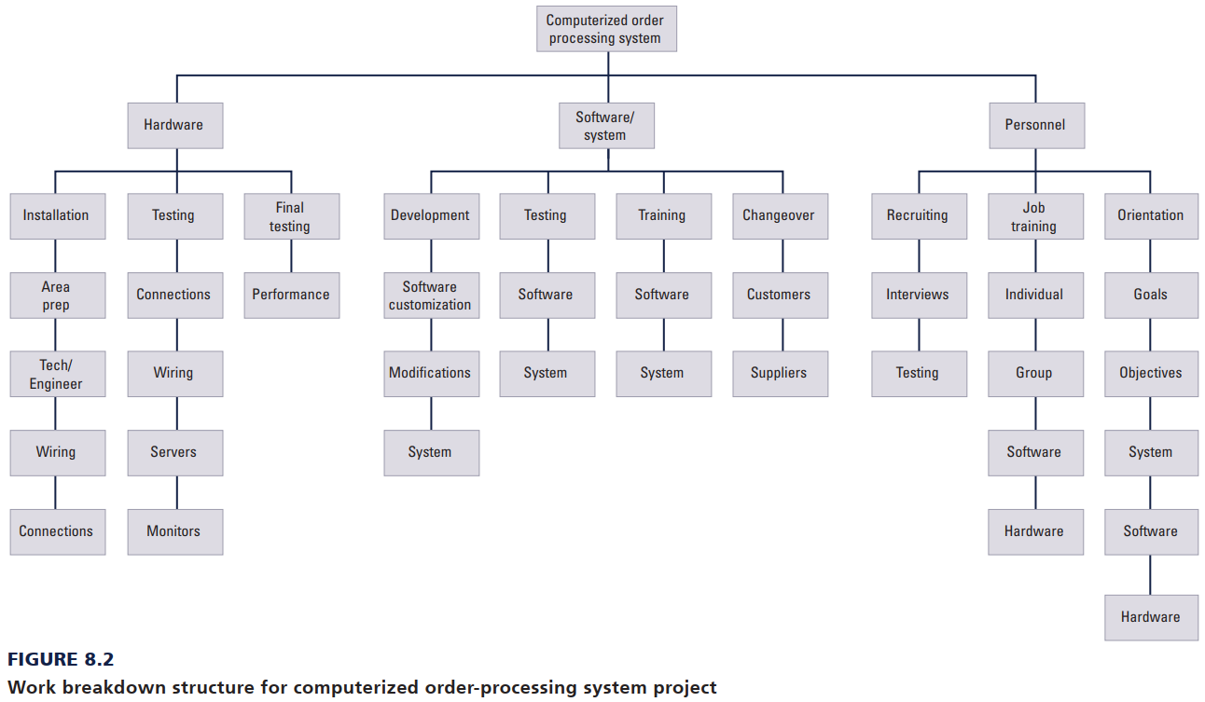
Work Breakdown Structure
A work breakdown structure (WBS) is an organizational chart that breaks down the project into modules for planning.
Source: Taylor III (2018)

Slide 9
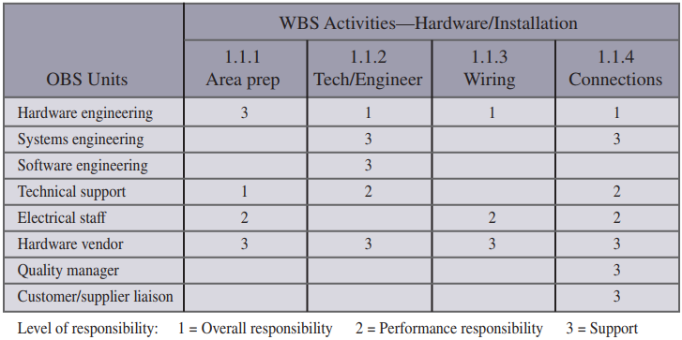
Responsibility Assignment Matrix
A responsibility assignment matrix is a table or chart that shows who is responsible for project work.
Source: Taylor III (2018)

Slide 10
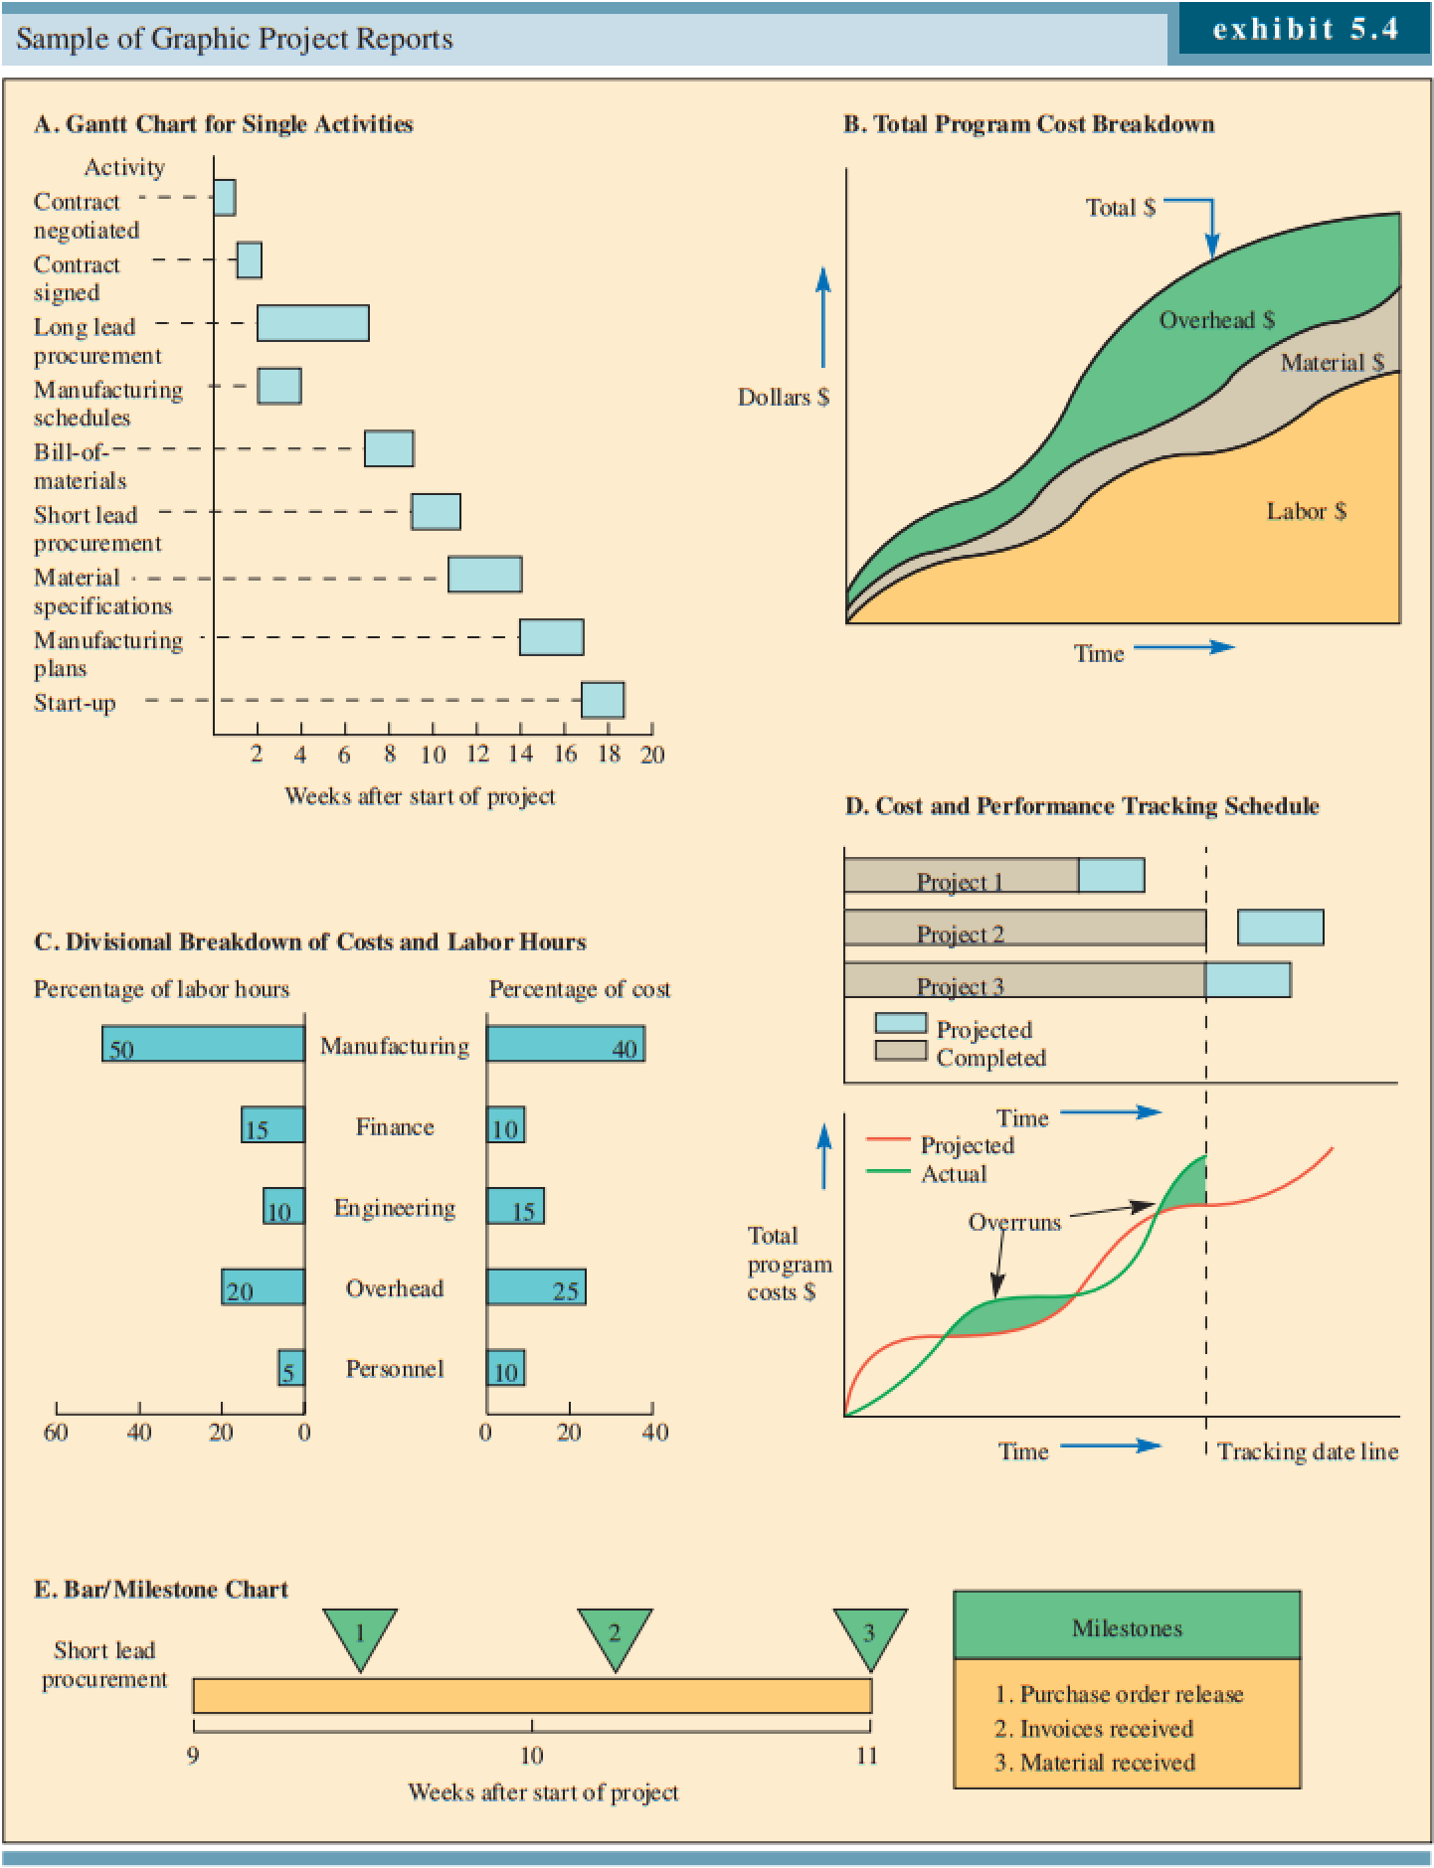
Managing projects
Source: Jacobs & Chase (2022)

Slide 11
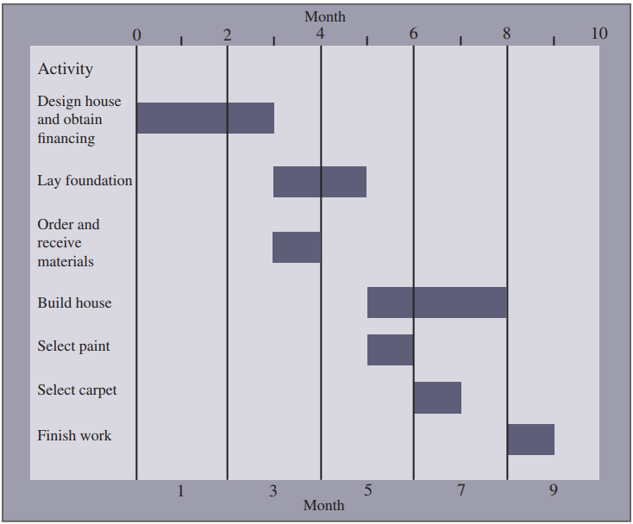
The Gantt Chart
A Gantt chart is a graph or bar chart with a bar for each project activity that shows the passage of time.
Source: Taylor III (2018)

Slide 12
Earned Value Management (EVM)
Earned value management (EVM) is a technique for measuring project progress in an objective manner. EVM has the ability to combine measurements of scope, schedule, and cost in a project. When properly applied, EVM provides a method for evaluating the relative success of a project at a point in time. The measures can be applied to projects focused on either “revenue generation” or “cost,” depending on the type of project.
Source: Jacobs & Chase (2022)

Slide 13
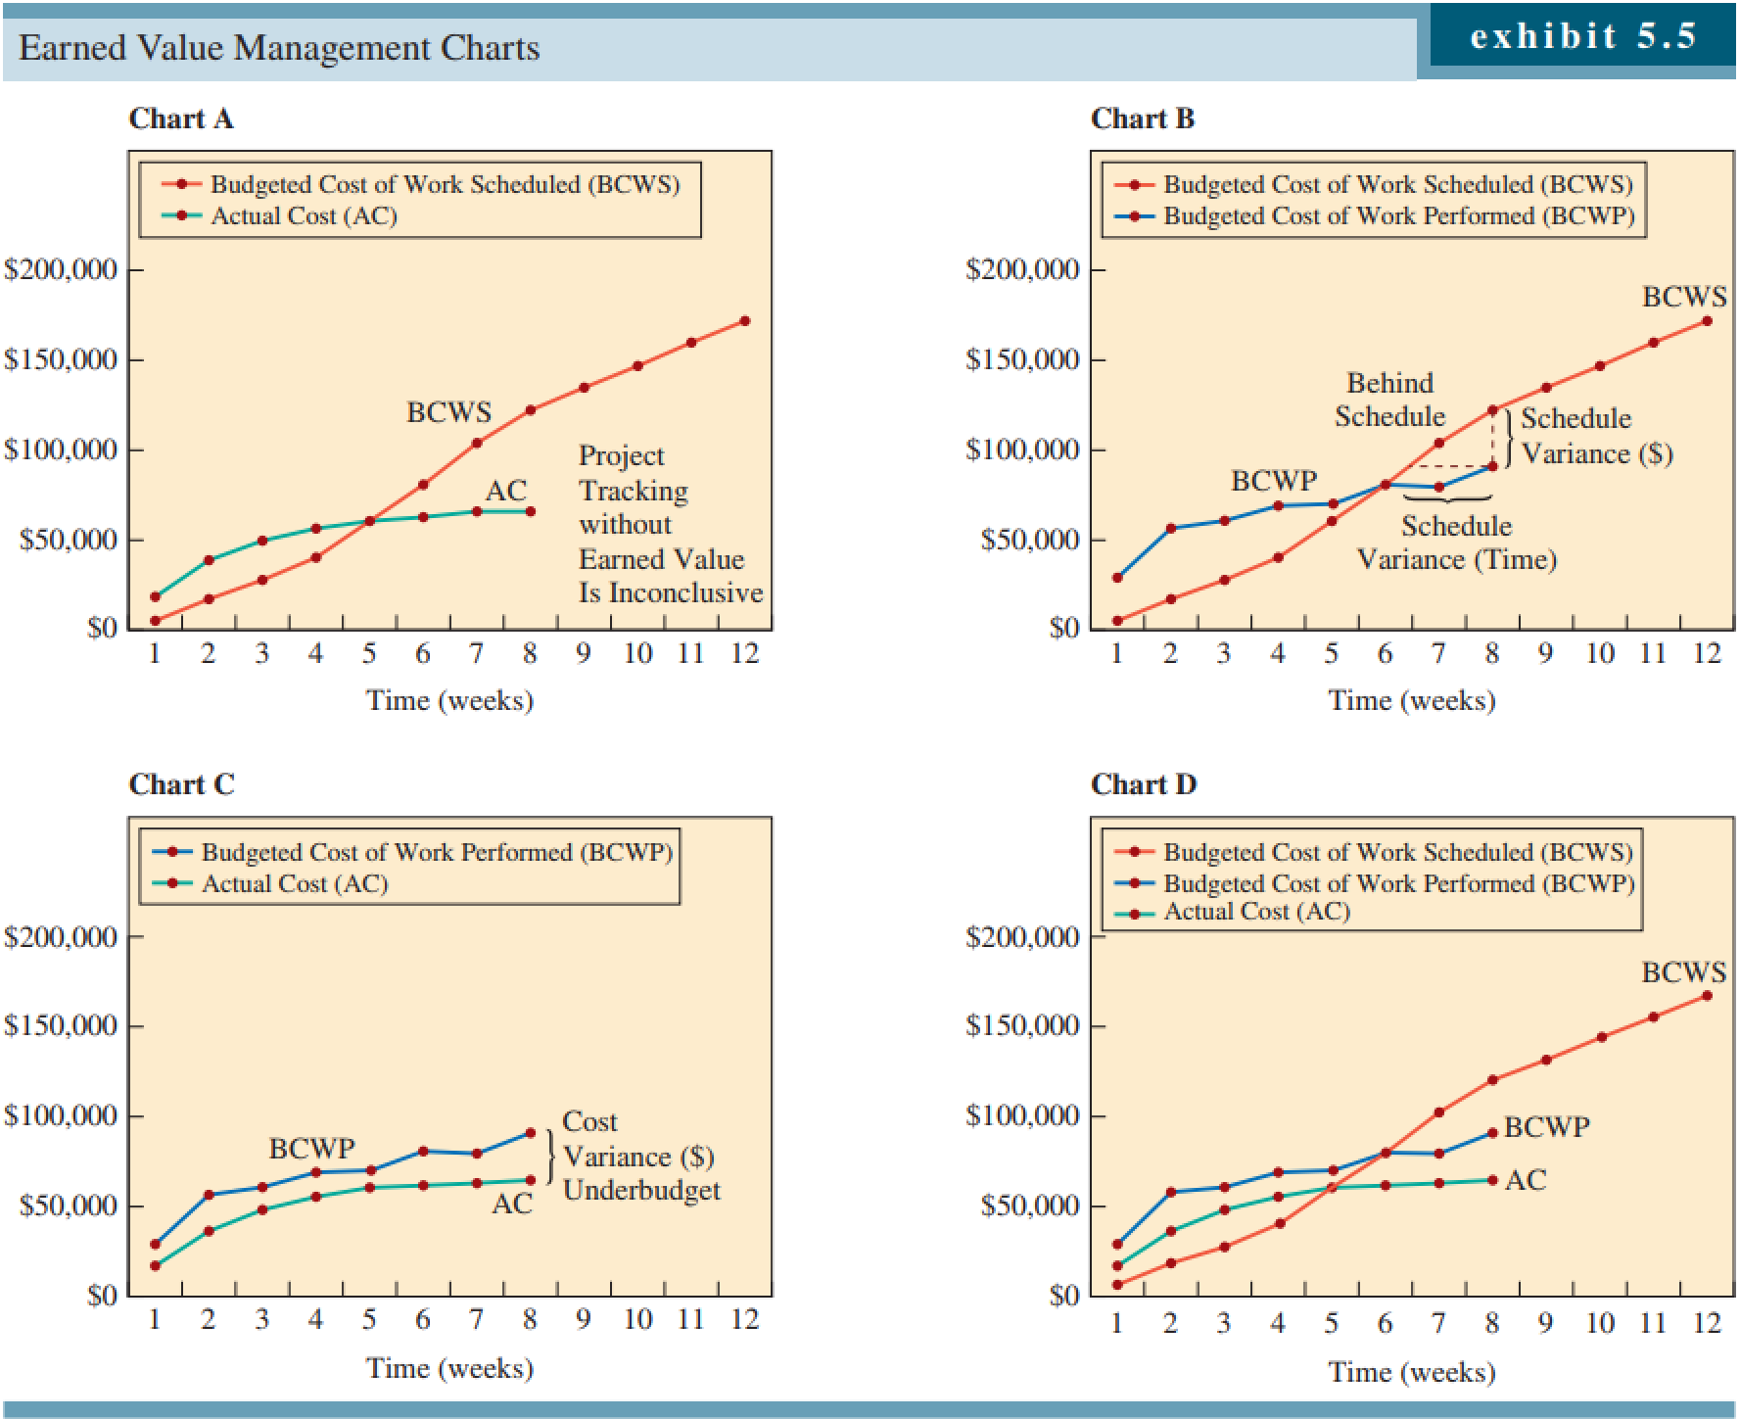
Source: Jacobs & Chase (2022)

Slide 14
Project Management - CPM and PERT
Critical Path Method (CPM) and Program Evaluation and Review Technique (PERT) are two scheduling techniques developed to enable project teams to schedule and manage enormous and complicated projects.
Critical path method (CPM) used a single activity time estimate, and in the network, activities were nodes.
Project evaluation and review technique (PERT) used multiple activity time estimates, and in the network, activities were lines between nodes.
Source: Paksoy & Deveci (2023), Taylor III (2018)

Slide 15
Project Management - CPM and PERT
PERT and CPM techniques use the following common primary six steps:
Describe the project and design the Work Breakdown Structure (WBS).
Determine the priority interrelationship of the activities.
Sketch project networks (PN) linking all activities.
Define the times for the activities.
Compute the lengthiest path on the PN (the critical path).
Utilize the PN to schedule and manage the project.
Source: Paksoy & Deveci (2023)

Slide 16
Project Management - CPM and PERT
The critical path of activities in a project is the sequence of activities that form the longest chain in terms of their time to complete. If any one of the activities in the critical path is delayed, then the entire project is delayed. It is possible and it often happens that there are multiple paths of the same length through the network, so there are multiple critical paths. Determining scheduling information about each activity in the project is the major goal of CPM techniques. The techniques calculate when an activity must start and end, together with whether the activity is part of the critical path.
Source: Jacobs & Chase (2022)

Slide 17
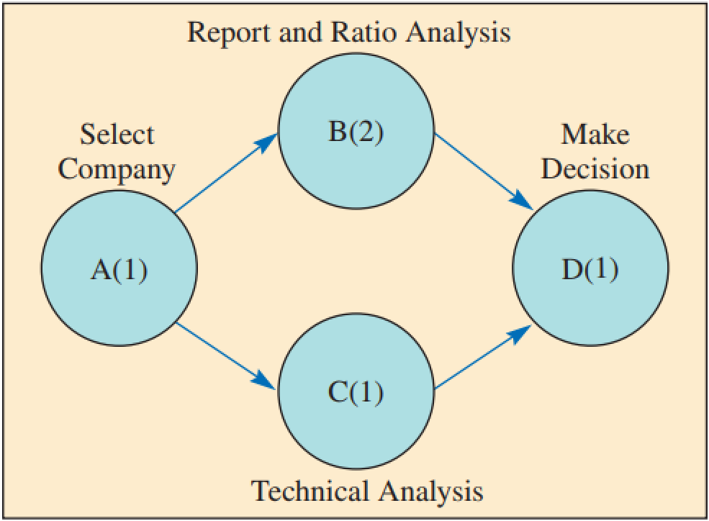
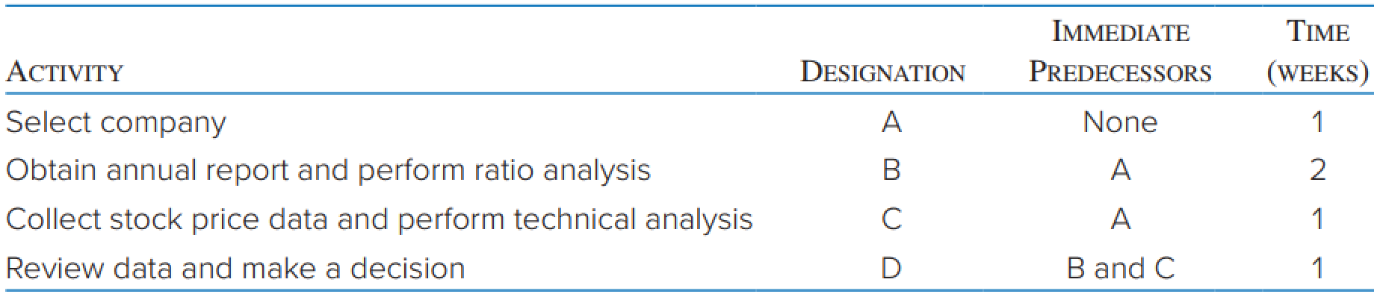
Critical Path Method (CPM)
Identify each activity to be done in the project and estimate how long it will take to complete each activity.
Determine the required sequence of activities and construct a network reflecting the precedence relationships.
Determine the critical path.
Determine the early start/finish and late start/finish schedule.
Source: Jacobs & Chase (2022)

Slide 18
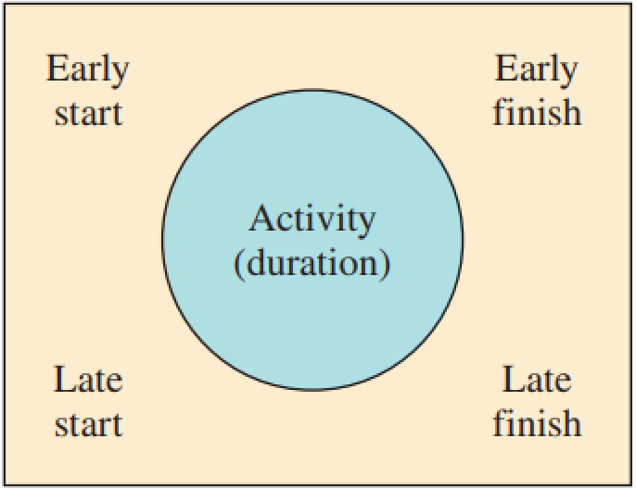
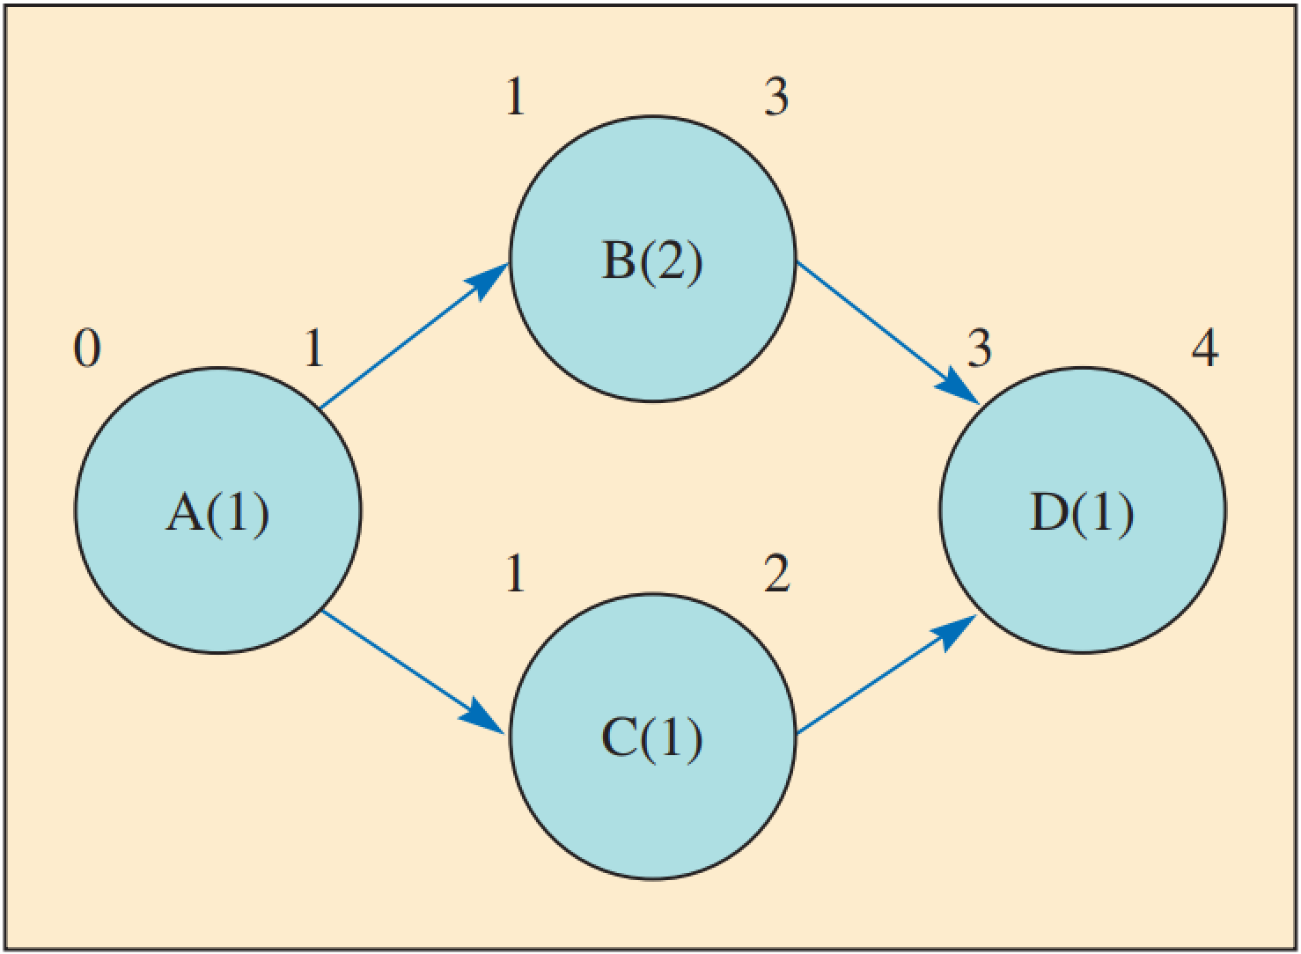
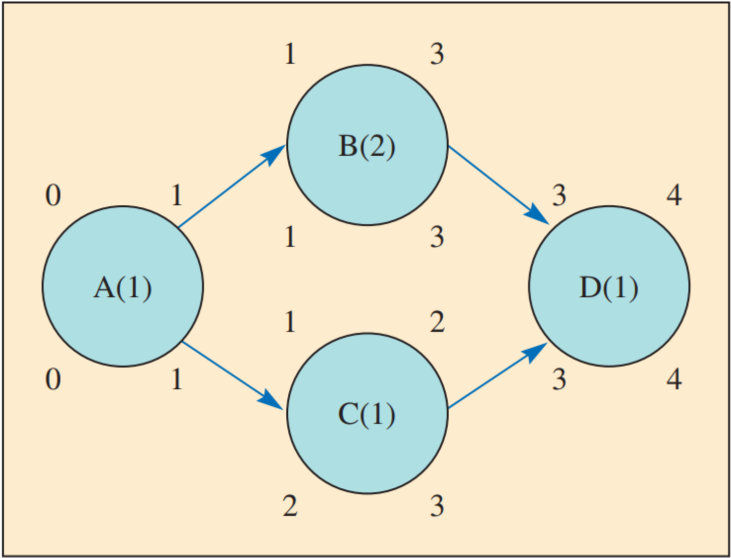
Critical Path Method (CPM)
Slack time (ST): The time that an activity can be delayed without delaying the entire project; the difference between the late and early start times of an activity. Activities with zero ST are critical activities and are on the critical path.
The critical path includes each critical activity, starting with the first activity and finishing with the last activity.
Source: Jacobs & Chase (2022)

Slide 19
Rule for calculating duration of project
Earliest start time rule: All predecessors must be completed before an activity can start.
Earliest finish time rule: The EF of an activity is equal to the sum of the activity’s ES and the duration.
Latest finish time rule: It is based on the principle that all predecessors must be completed before an activity can begin.
Latest start time rule: The LS of an activity is equal to the difference between its LF and the time of the activity.
Source: Paksoy & Deveci (2023)

Slide 20
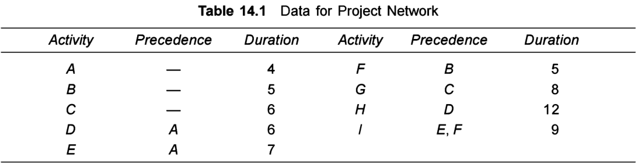
Example: Build up project network

Slide 21
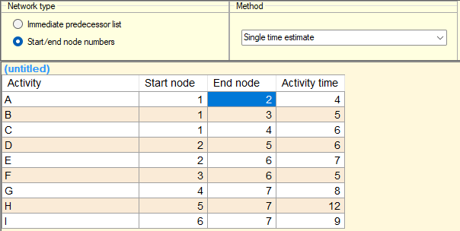
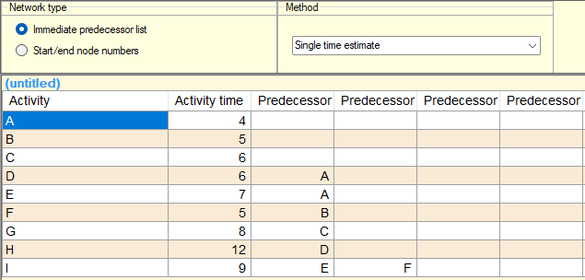

Slide 22
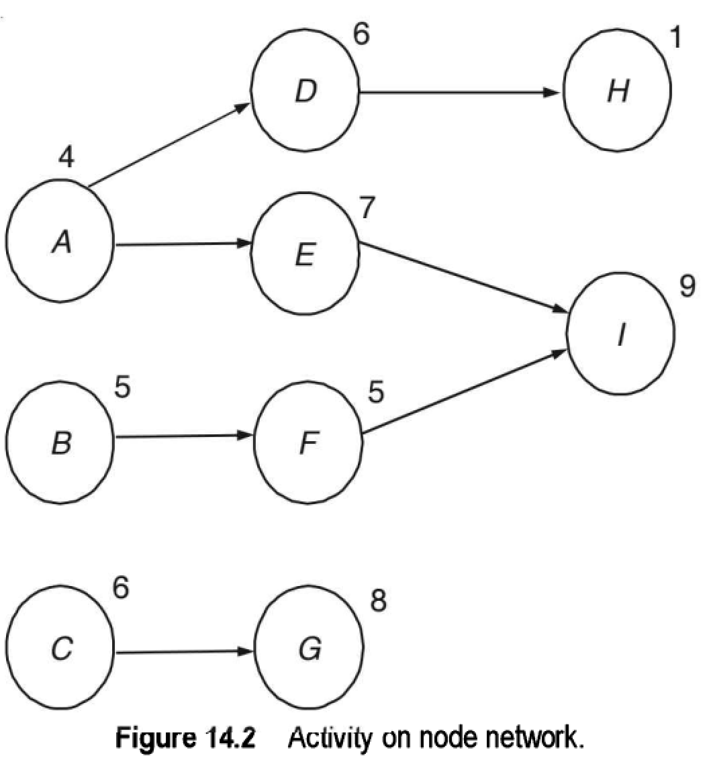
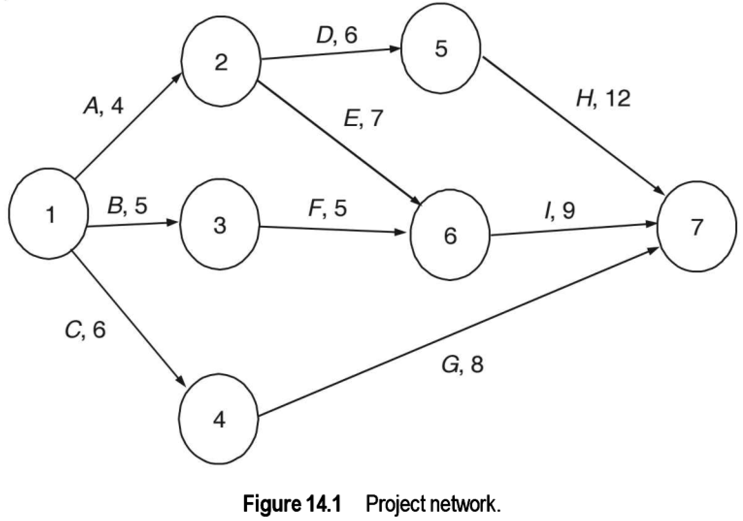

Slide 23
Example: Build up project network
Compute the duration for all the paths and compute the earliest project completion time.
Identify the critical path and the critical activities.
What happens when the durations of activity H are 8 and 14?
What happens when the durations of activity I become 10, 11 and 14?

Slide 24
Example: Build up project network
Path 1: 1-2-5-7 (activities A, D and H) with duration = 4 + 6 + 12 = 22
Path 2: 1-2-6-7 (activities A, E and I) with duration = 4 + 7 + 9 = 20
Path 3: 1-3-6-7 (activities B, F and I) with duration = 5 + 5 + 9 = 19
Path 4: 1-4-7 (activities C and G) with duration = 6 + 8 = 14
The longest path is called the critical path and this method of finding the critical path is called the critical path method (CPM).
Activities that are in the critical path are the critical activities.

Slide 25
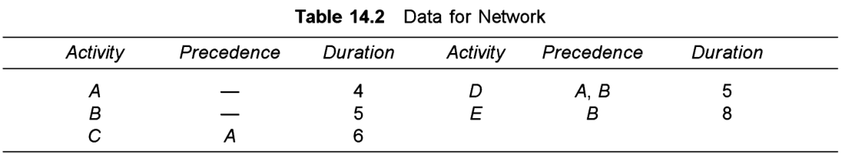
Example: Build up project network

Slide 26
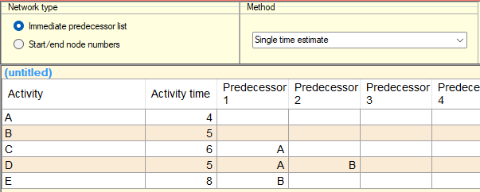

Slide 27
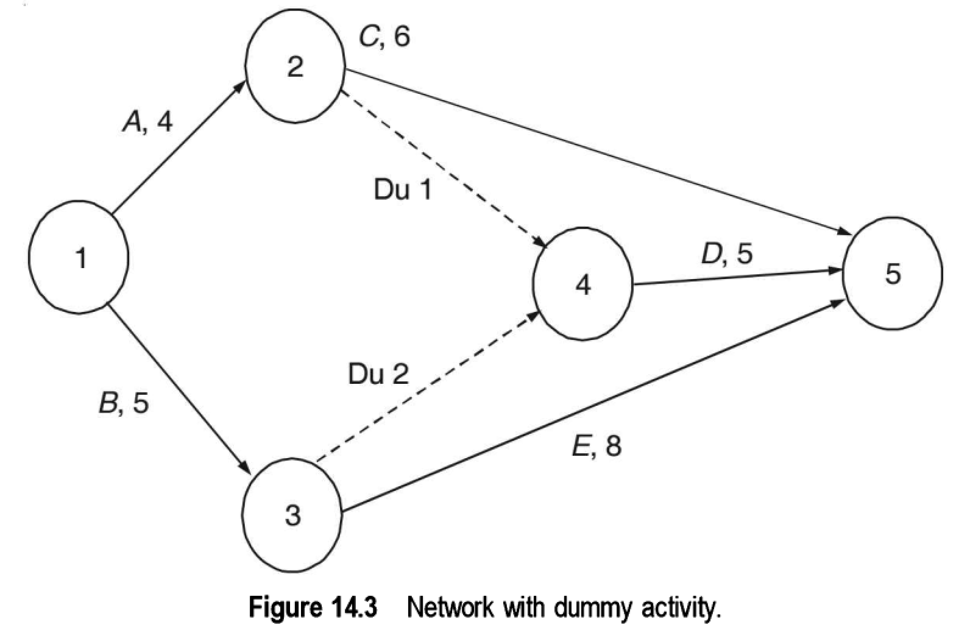

Slide 28
Project crashing
The project duration is the earliest time all the activities are completed and for given values of the duration of the activities cannot be reduced further.
It is assumed here that by investing in resources, it is possible to reduce the duration (activity times) of some activities at increased cost. This process of reducing the time to complete the project (from the CPM solution) is called crashing the project.
Constraints: budget, fixed cost…
Source: Srinivasan (2017)

Slide 29
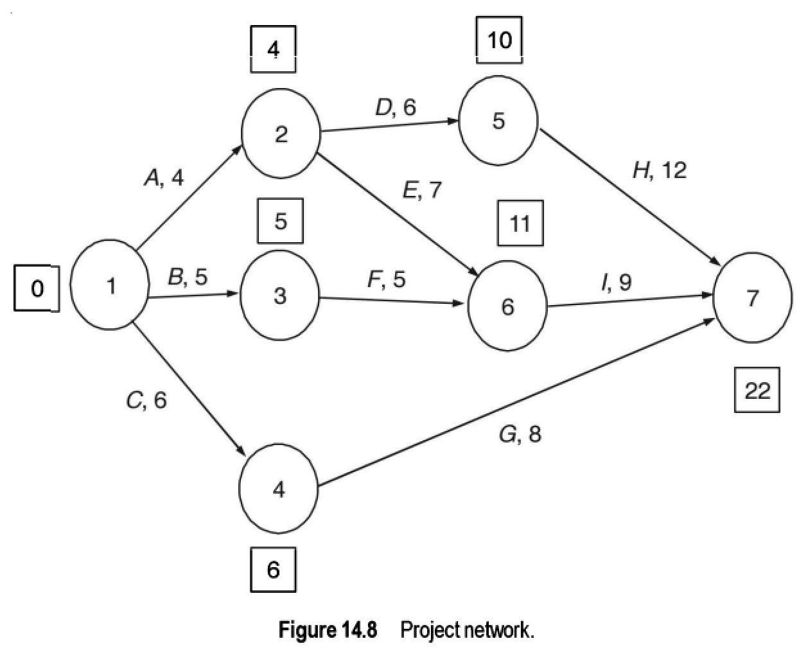
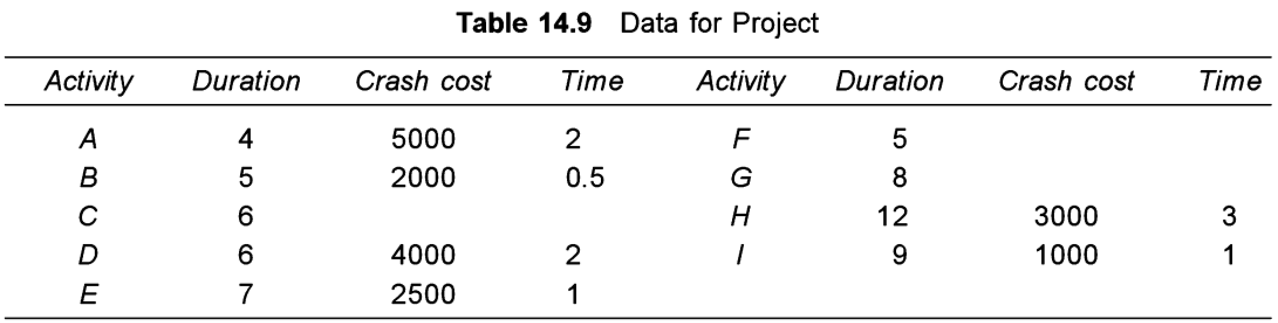
Example
The cost of crashing an activity (per unit time) and the extent to which the activity can be crashed is given in the table. Also consider the fixed cost per unit time to be $5000. How do we define optimal duration of project with the appropriate crashing cost?

Slide 30
Define critical paths, duration and costs
Length = 22; Path = A—D—H; extra cost = 0
Length = 21; Path = A—D—H; extra cost = $3000
Length = 20; Paths = A—D—H; A—E—I; extra cost = $6000
Length = 19; Paths = A—D—H; A—E—I; extra cost = $10000
Length = 18; Paths = A—D—H; A—E—I; B—F—I; extra cost = $15000
Length = 17.5; Paths A—D—H; A—E—I; B—F—I; extra cost = $18500

Slide 31
The total cost for various project durations are as follows:
Duration = 22; Total cost = 22 x 5000 + 0 = $110,000
Duration = 21; Total cost = 21 x 5000 + 3000 = $108,000
Duration = 20; Total cost = 20 x 5000 + 6000 = $106,000
Duration = 19; Total cost = 19 x 5000 + 10000 = $105,000
Duration = 18; Total cost = 5000 x 18 + 15000 = $105,000
Duration = 17.5; Total cost = 5000 x 17.5 + 18500 = $106,000

Slide 32
Program Evaluation and Review Technique (PERT)
When the activity times are deterministic and known, we use CPM to find the project duration. We use PERT when the activity times are probabilistic.
Source: Srinivasan (2017)

Slide 33
Probability of project completion
In PERT, probability distributions according to three time estimates can be used:
Optimistic time (a): The time needed to perform the activity if all goes well as planned.
Pessimistic time (b): The time needed for the activity to be carried out if everything goes very negatively.
Most likely time (m): The most realistic time an activity needs to be performed.
Source: Paksoy & Deveci (2023)

Slide 34
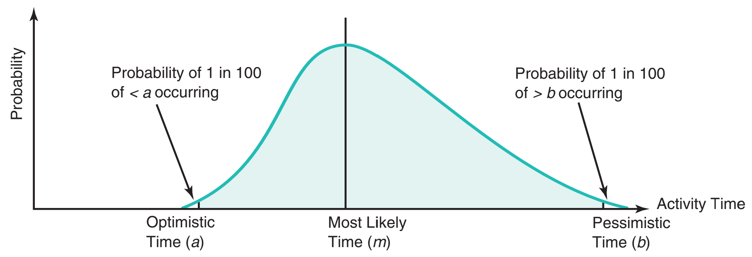
Beta Probability Distribution with Three Time Estimates
Source: Heizer, Render, & Munson (2020)

Slide 35
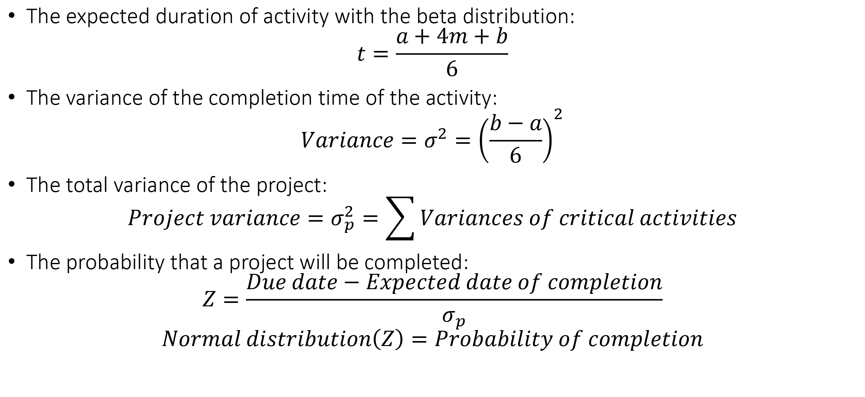
Probability of project completion
The expected duration of activity with the beta distribution:
$$t=\frac{a+4m+b}{6}$$
The variance of the completion time of the activity:
$${Variance=σ}^{2}={\left(\frac{b−a}{6}\right)}^{2}$$
The total variance of the project:
$$Project variance=σ_{p}^{2}=\sum{Variances of critical activities}$$
The probability that a project will be completed:
$$Z=\frac{Due date−Expected date of completion}{σ_{p}}$$
$$Normal distribution\left(Z\right)=Probability of completion$$
Source: Paksoy & Deveci (2023)

Slide 36
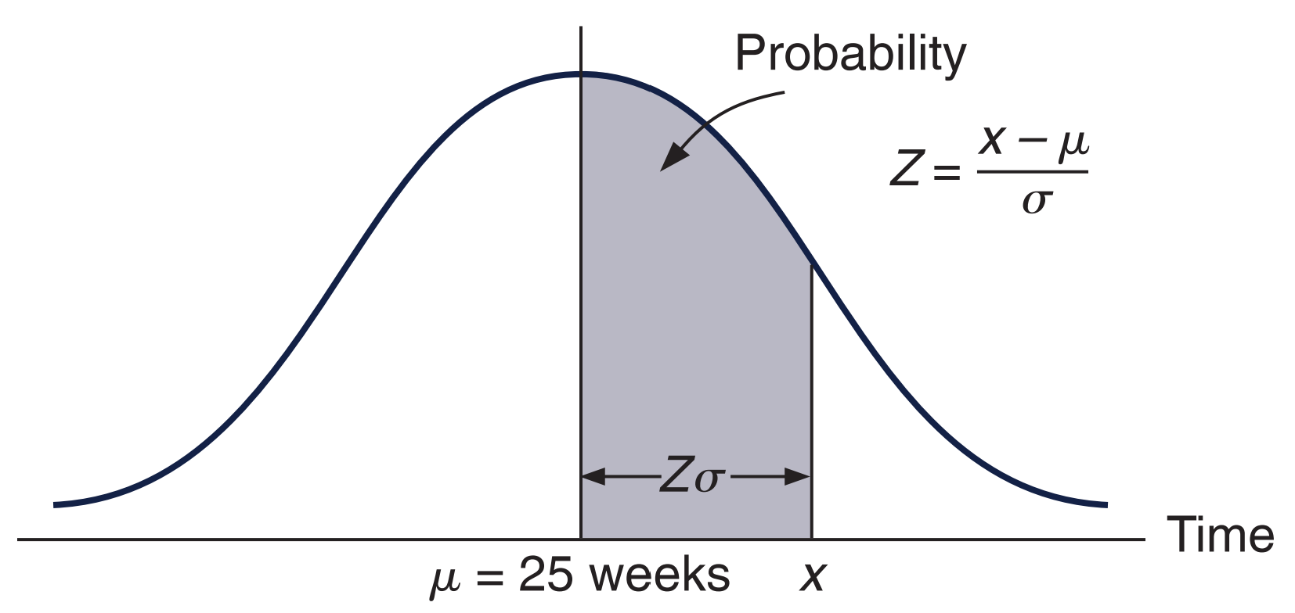
Normal distribution of network duration
Source: Taylor III(2018)

Slide 37
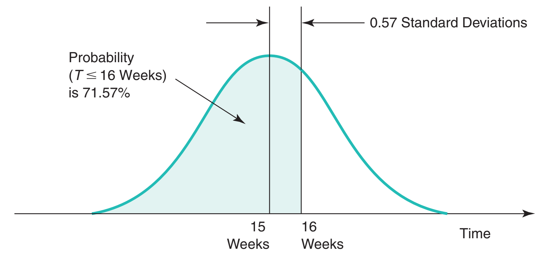
Probability that the network will be completed in 16 weeks or less
Source: Heizer, Render, & Munson (2020)

Slide 38
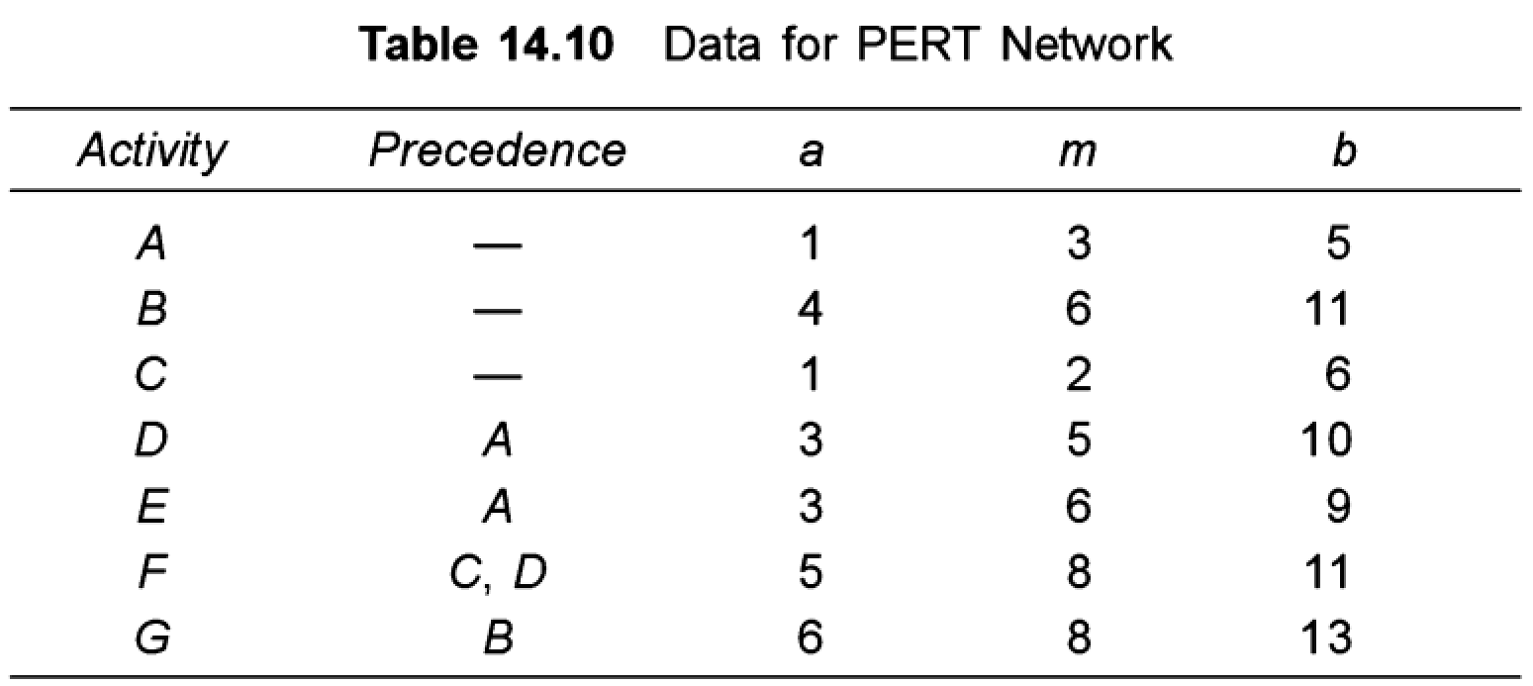
Example
Consider the project involving six activities shown in Table 14.10. The precedence and estimates of the activity times (in days) are shown in the table. Find the expected activity time and its variance for the activities. Identify the expected critical path using ideas from CPM. What is the probability of completing the project within 15 days?

Slide 39
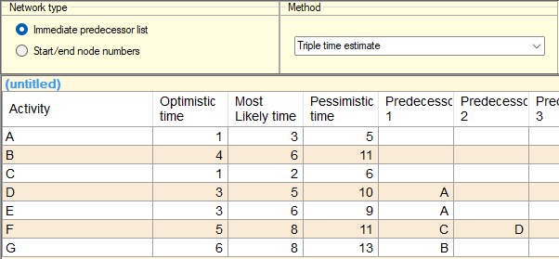
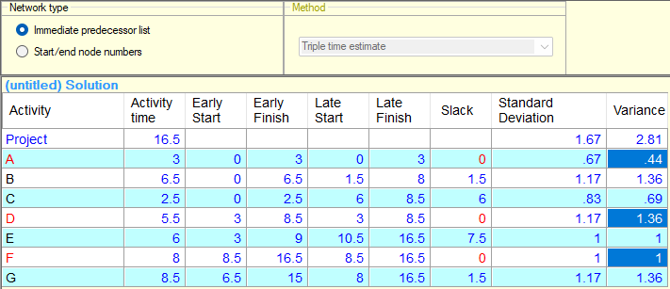

Slide 40
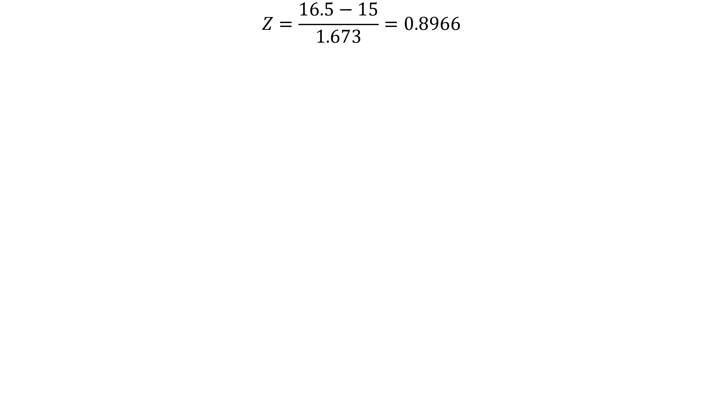
$$Z=\frac{16.5−15}{1.673}=0.8966$$
Length | Z-score | Probability |  | Variance | 2.8
12 | -2.689 | 0.004 |  | Mean | 16.5
13 | -2.092 | 0.018 |  | Std. deviation | 1.673
14 | -1.494 | 0.068
15 | -0.896 | 0.185
16 | -0.299 | 0.383
17 | 0.299 | 0.617
18 | 0.896 | 0.815
19 | 1.494 | 0.932
20 | 2.092 | 0.982

Slide 41
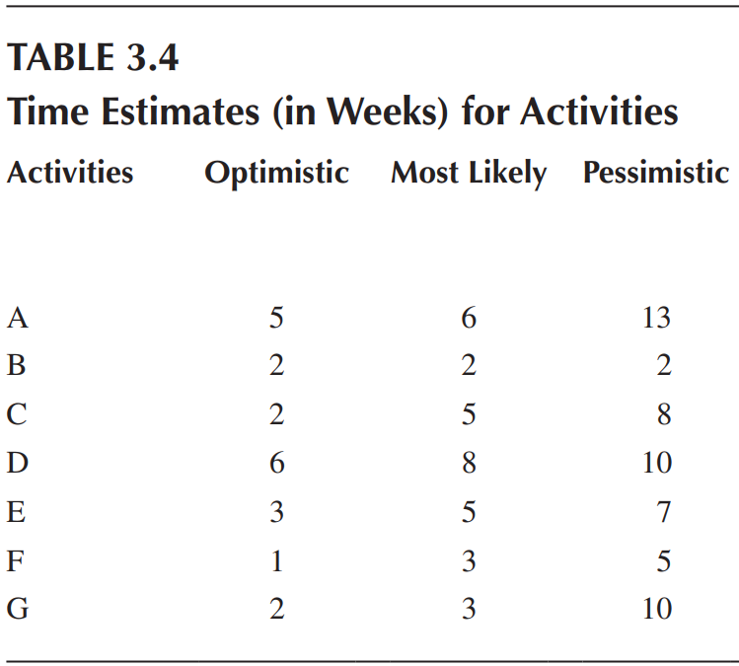
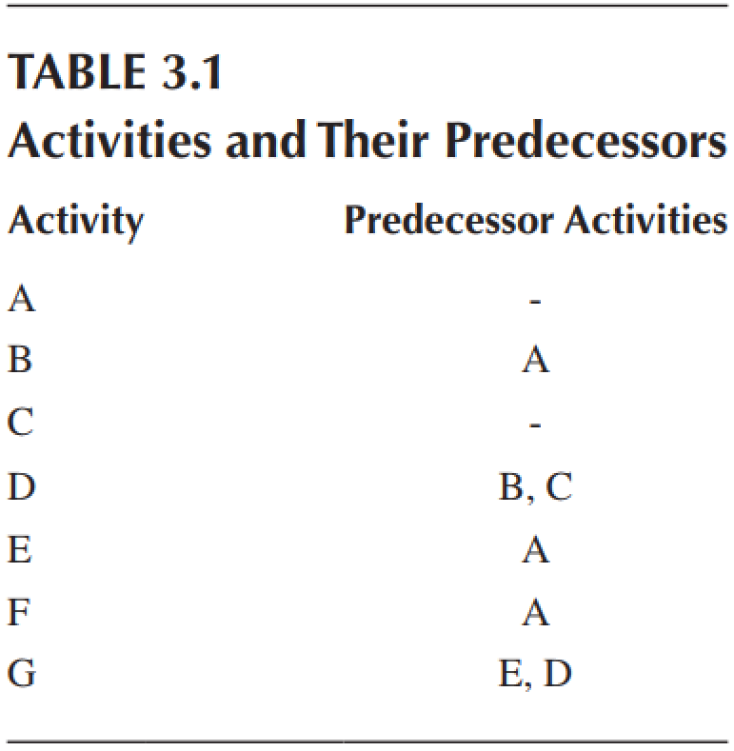
Problem set: Project network (PN)
Build up project network
How many weeks can the project be completed?
Calculate the probability of project completion before 20 weeks.

Slide 42
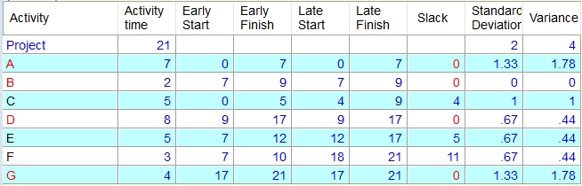
Length | Z-score | Probability |  | Variance | 4
12 | -4.500 | 0.000 |  | Mean | 21
13 | -4.000 | 0.000 |  | Std. deviation | 2.000
14 | -3.500 | 0.000
15 | -3.000 | 0.001
16 | -2.500 | 0.006
17 | -2.000 | 0.023
18 | -1.500 | 0.067
19 | -1.000 | 0.159
20 | -0.500 | 0.309

Slide 43
Cost-time trade-offs and project crashing
CPM is a technique where activities used in calculations have a standard time. Each activity has an expected cost calculated over a standard time.
The shortest time required to complete activities is called Crash Time (CT). Every activity with CT has a Cost of Crash (CM). Extra resources are often needed to complete activities in less time than expected.
Therefore, the CM of an activity is more than its standard cost. The amount of time an activity can be shortened depends on the type of activity. For this reason, some activities can be shortened significantly, while others cannot be shortened at all. Similarly, the CM of an activity depends on the nature of the activity.
Source: Paksoy & Deveci (2023)

Slide 44
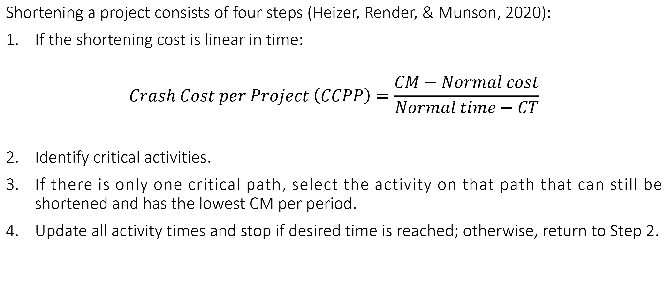
Cost-time trade-offs and project crashing
Shortening a project consists of four steps (Heizer, Render, & Munson, 2020):
If the shortening cost is linear in time:
$$Crash Cost per Project \left(CCPP\right)=\frac{CM−Normal cost}{Normal time−CT}$$
Identify critical activities.
If there is only one critical path, select the activity on that path that can still be shortened and has the lowest CM per period.
Update all activity times and stop if desired time is reached; otherwise, return to Step 2.
Source: Paksoy & Deveci (2023)

Slide 45
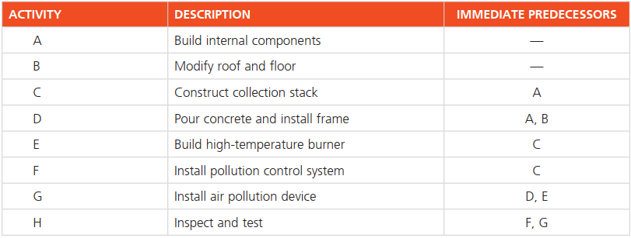
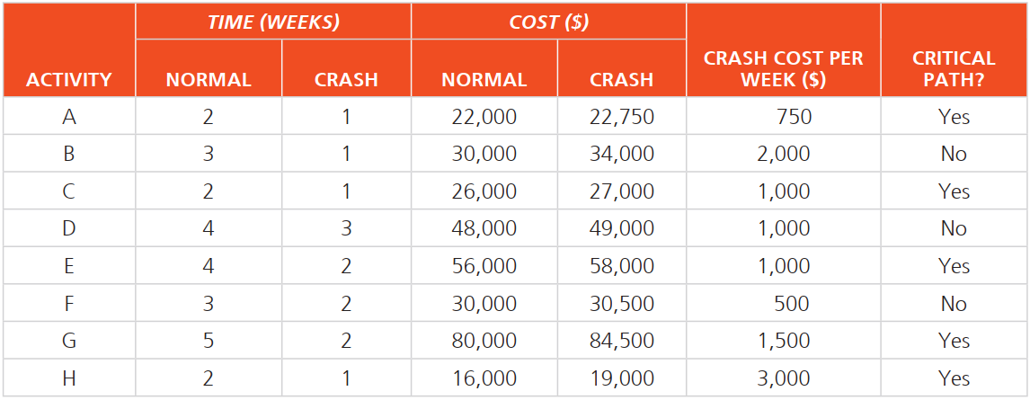
Example: Project crashing to meet a deadline at Milwaukee Paper
Suppose the plant manager at Milwaukee Paper Manufacturing has been given only 13 weeks (instead of 16 weeks) to install the new pollution control equipment. As you recall, the length of Julie Ann Williams’s critical path was 15 weeks, but she must now complete the project in 13 weeks.

Slide 46
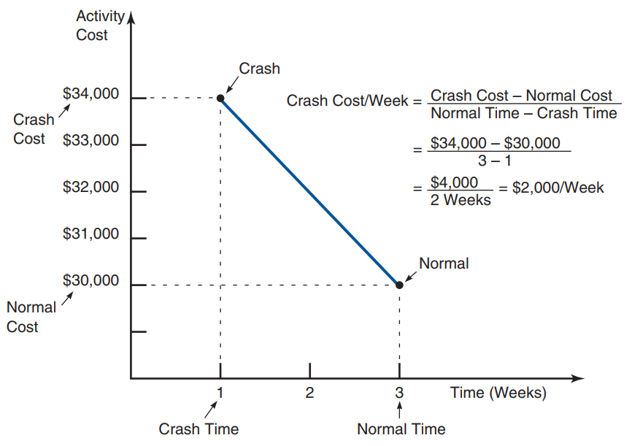

Slide 47
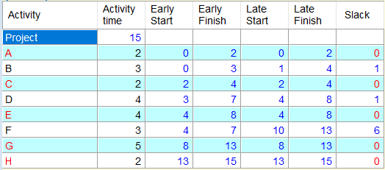
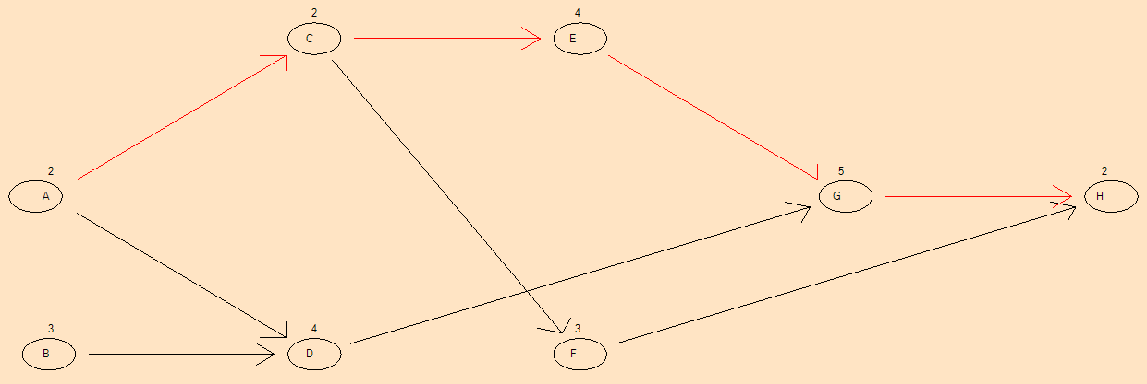

Slide 48
Example: Project Crashing with Linear Programming
X_{A} = EF for activity A
X_{B} = EF for activity B
X_{C} = EF for activity C
X_{D} = EF for activity D
X_{E} = EF for activity E
X_{F} = EF for activity F
X_{G} = EF for activity G
X_{H} = EF for activity H
X_{start} = start time for project (usually 0)
X_{finish} = earliest finish time for project

Slide 49
Objective function
Minimize crash cost = 750Y_{A} + 2,000Y_{B} + 1,000Y_{C} + 1,000Y_{D} + 1,000Y_{E} + 500Y_{F} + 1,500Y_{G} + 3,000Y_{H}

Slide 50
Crash time constraint
Y_{A} ≤ 1
Y_{B} ≤ 2
Y_{C} ≤ 1
Y_{D} ≤ 1
Y_{E} ≤ 2
Y_{F} ≤ 1
Y_{G} ≤ 3
Y_{H} ≤ 1

Slide 51
Project completion constraint
X_{finish} ≤ 12

Slide 52
Constraints describing the network
Every activity will have one constraint for each of its predecessors. The form of these constraints is:
Earliest finish time ≥ Earliest finish time for predecessor + Expected activity time
EF ≥ EF_{predecessor} + (t - Y)
or
X ≥ X_{predecessor} + (t - Y)

Slide 53
Constraint for each activity
For activity A:
X_{A} ≥ X_{start} + (2 - Y_{A})
or X_{A} - X_{start} + Y_{A} ≥ 2
For activity B:
X_{B} - X_{start} + Y_{B} ≥ 3
For activity C:
X_{C} - X_{A} + Y_{C} ≥ 2
For activity D:
X_{D} - X_{B} + Y_{D} ≥ 4

Slide 54
Constraint for each activity
For activity A:
01
For activity B:
02
For activity C:
03
XA ≥ Xstart + (2 - YA)
or XA - Xstart + YA ≥ 2
XB - Xstart + YB ≥ 3
XC - XA + YC ≥ 2
For activity D:
04
Your title here
05
Your title here
06
XD - XB + YD ≥ 4
Click here to add text
Click here to add text

Slide 55
Constraint for each activity
For activity E:
X_{E} - X_{C} + Y_{E} ≥ 4
For activity F:
X_{F} - X_{C} + Y_{F} ≥ 3
For activity G:
X_{G} - X_{D} + Y_{G} ≥ 5
X_{G} - X_{E} + Y_{G} ≥ 5
For activity H:
X_{H} - X_{F} + Y_{H} ≥ 2
X_{H} - X_{G} + Y_{H} ≥ 2
To indicate the project is finished when activity H is finished:
X_{finish} ≥ X_{H}

Slide 56
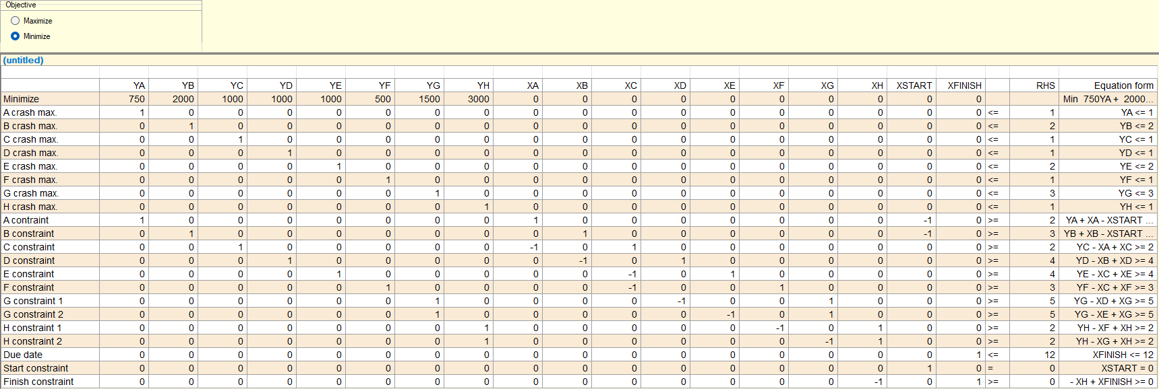

Slide 57
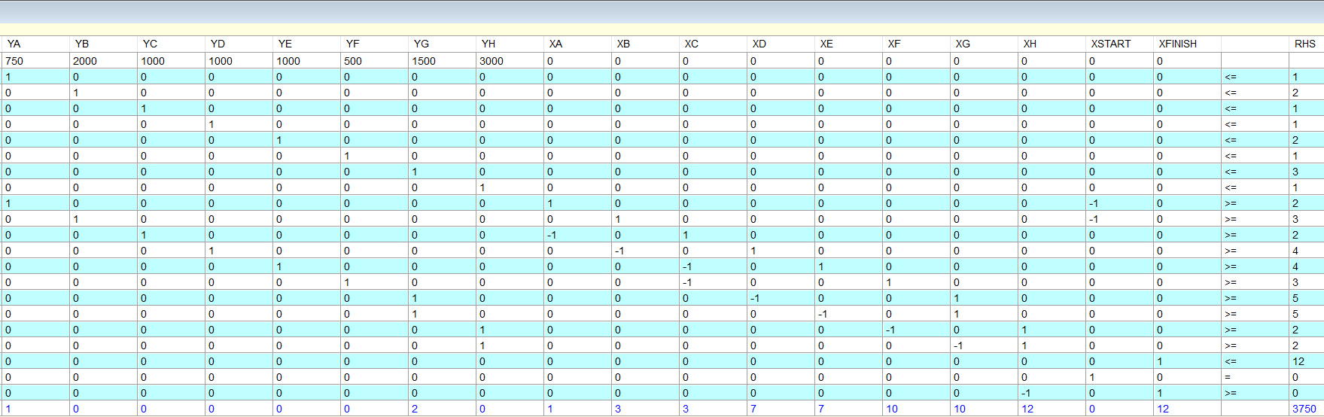

Slide 58
Project scheduling
The critical path method provides the critical path and its length (L). The length of the critical path is the sum of the activity times of the critical activities. In order to complete the project within L, the critical activities have to be scheduled sequentially so that they are completed within L units. The non-critical activities can be scheduled in parallel and the floats associated with these activities provide us the time slabs within which the non-critical activities can be completed. The project schedule is a time-table for carrying out the activities.
We require resources to carry out the various activities and in practice we use multiple resources. When we analyzed the project using CPM, we assumed that required amount of the resources are available at any point in time. In practice, we could encounter limited resources or have to estimate the amount of resource actually required to execute the project.
Source: Srinivasan (2017)

Slide 59
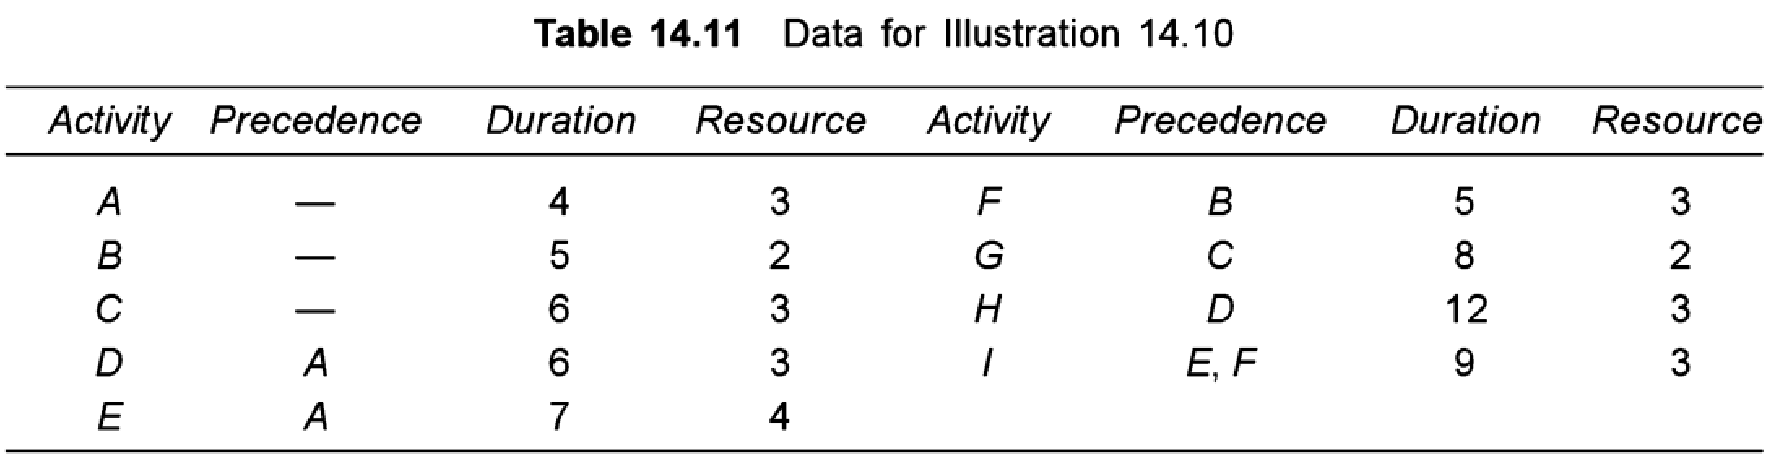
Example
Consider the project involving six activities shown in Table 14.11. The precedence and estimates of the activity times (in days) are shown in the table. Draw a schedule and find out the amount of resource required at different points in time.

Slide 60
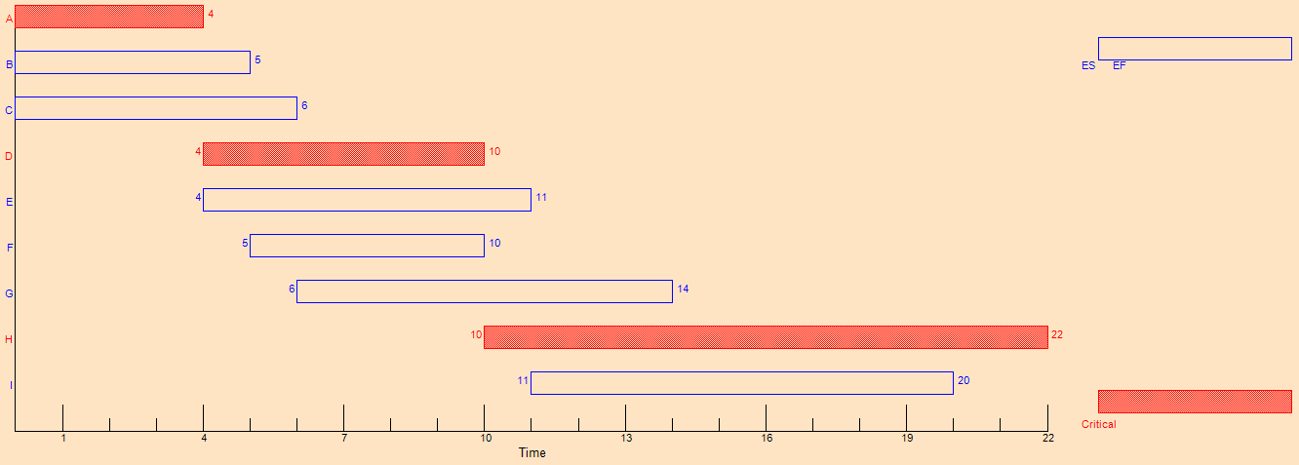

Slide 61
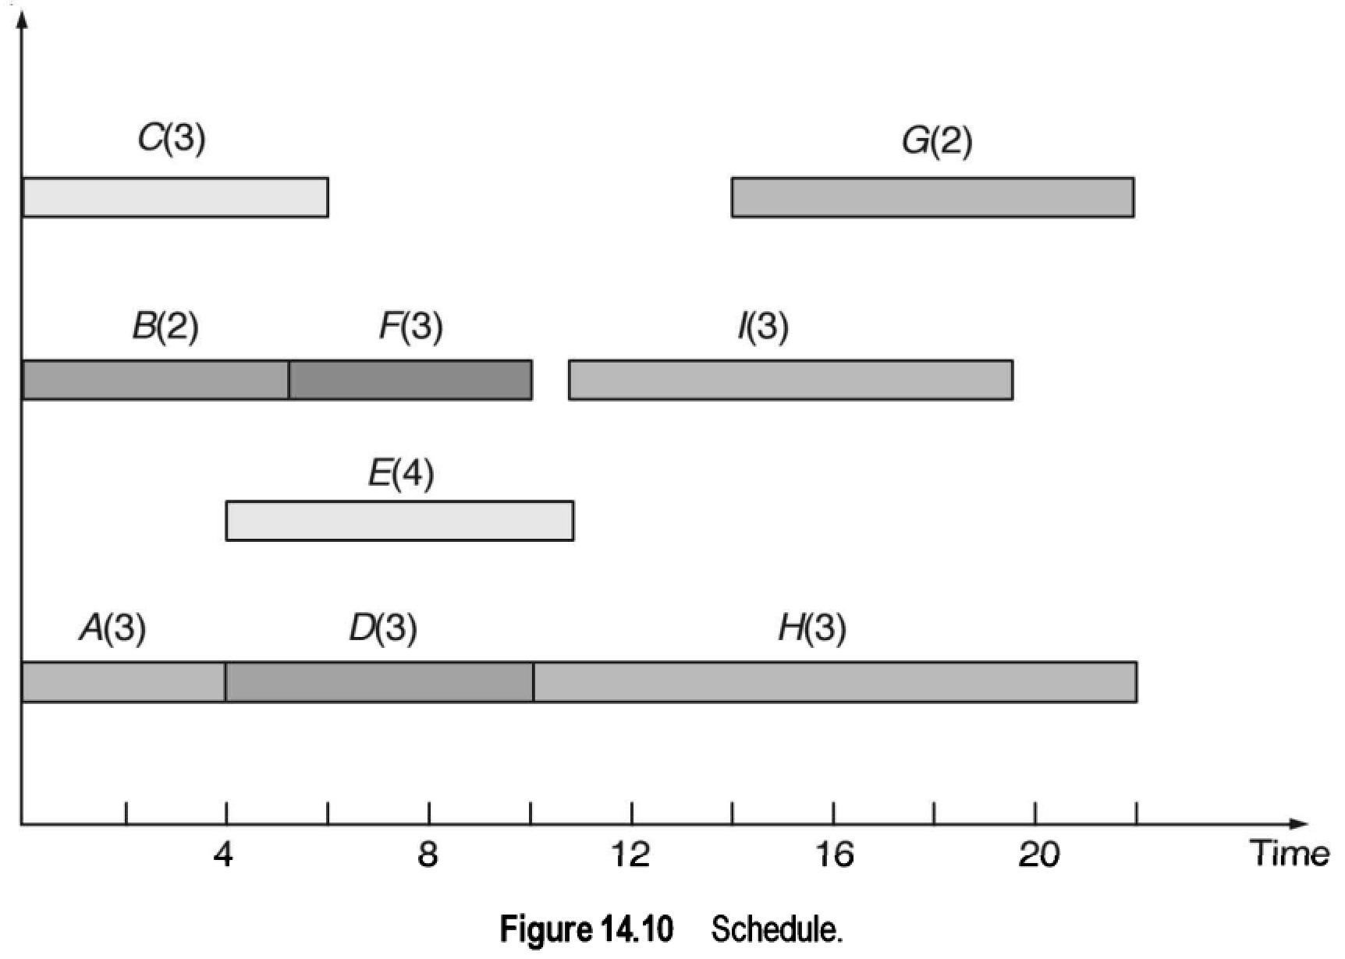
Maximum resource =13
We can schedule I between 13 and 22
We can schedule E between 6 and 13

Slide 62
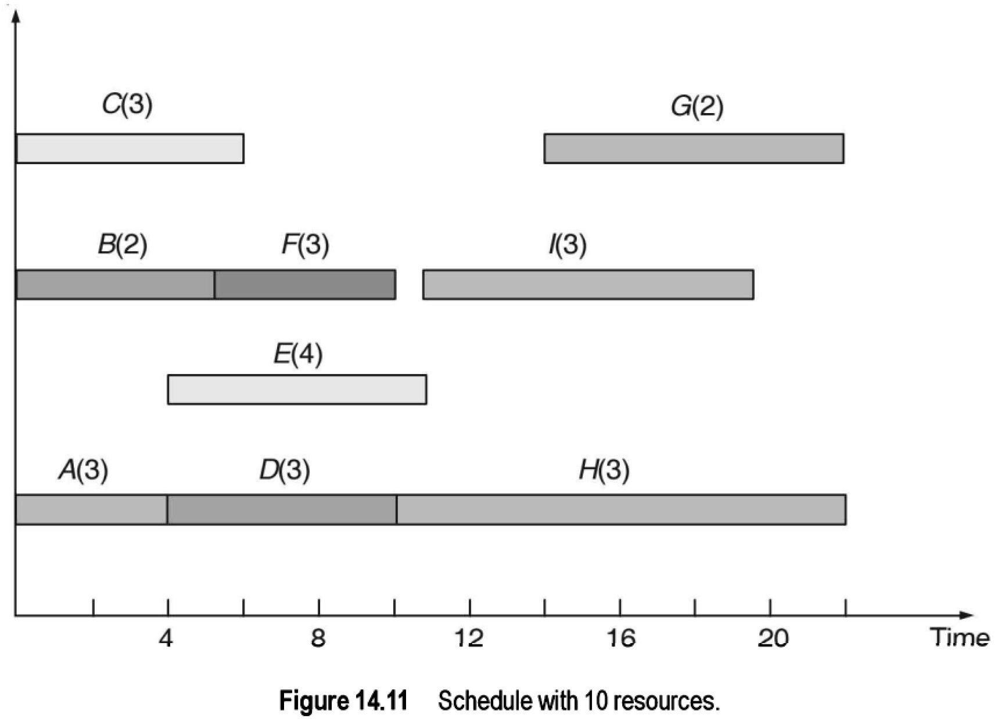

Slide 63
Managing with limited resources
Above example explained a way to compute the minimum amount of the resource required (say, R) to schedule and complete the project within L units. The approach explained through this illustration is heuristic and is not expected to guarantee the optimum always. Better methods are available to find the minimum amount of resource available.
It is also possible that we have fewer than R amount of the resource. This means that some activities have to delayed to get the resources which would delay the project completion beyond L. The next issue is to find out the completion time of the project considering limited resources.
We present a heuristic solution using the following rule: From the list of activities that are available, schedule the activity that takes minimum time for the required amount of resource is available. This is an adaptation of the familiar shortest processing time (SPT) rule.
Source: Srinivasan (2017)

Slide 64
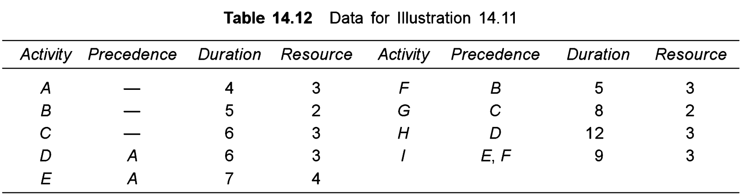
Example
Consider the project involving six activities shown in Table 14.12. The precedence and estimates of the activity times (in days) are shown in the table. Schedule the activities to determine the project completion time if only 6 units of the resource is available.

Slide 65
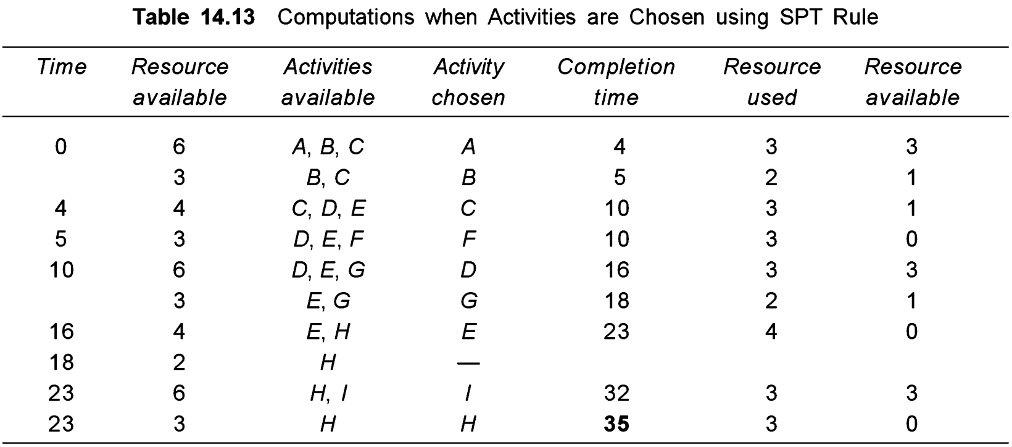
The computations when activities are chosen based on the SPT rule

Slide 66
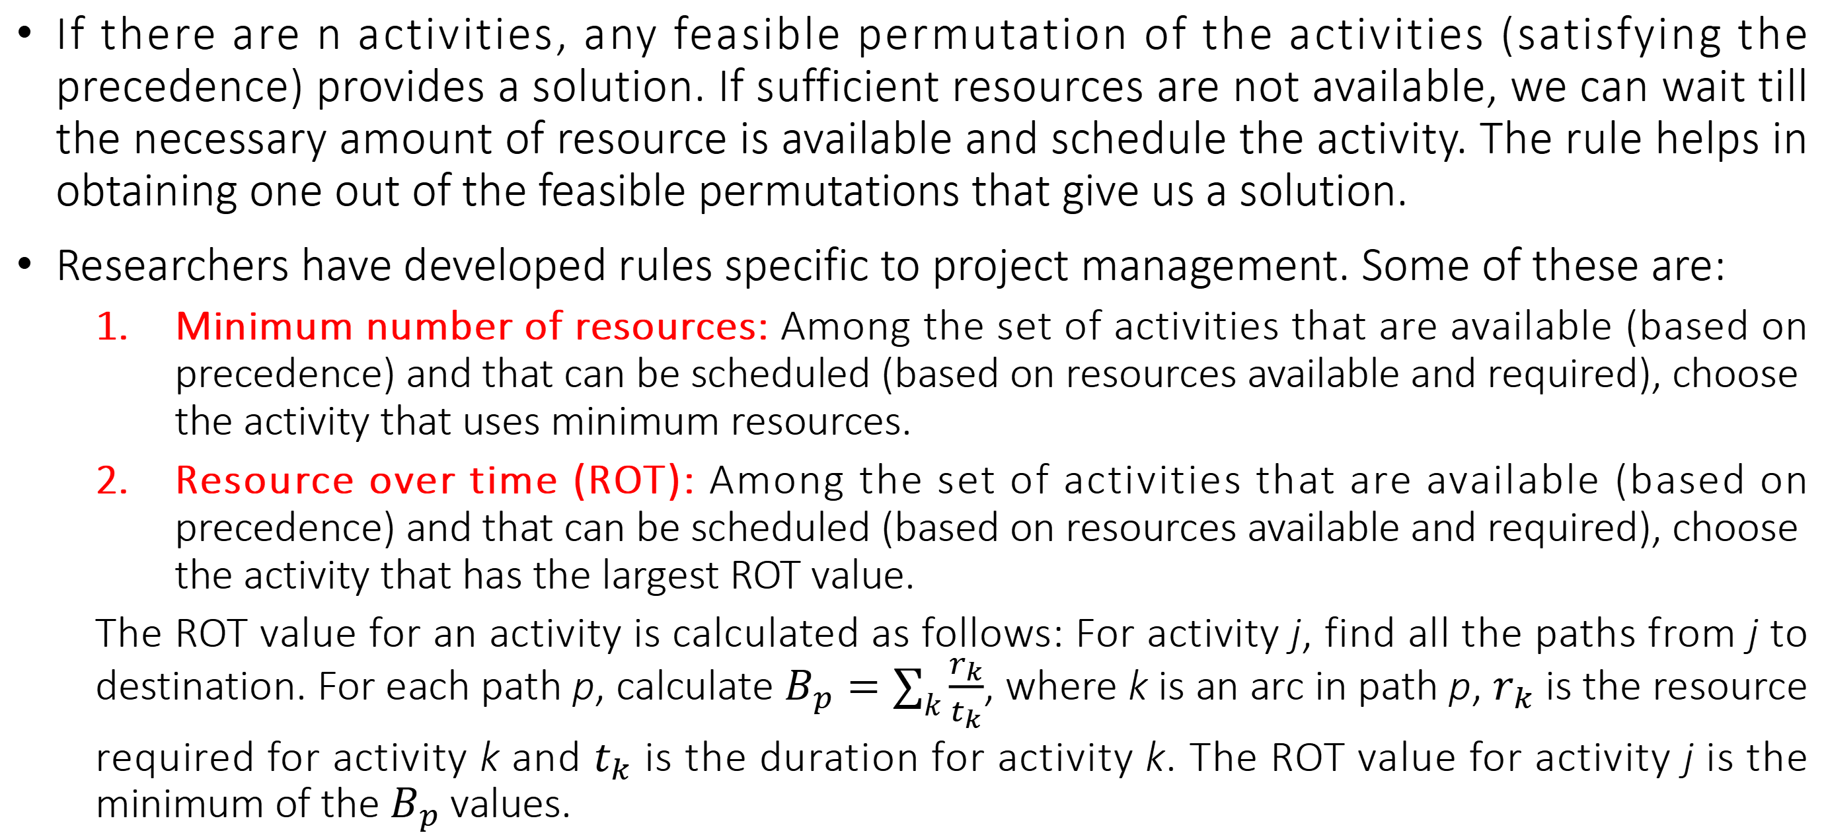
Managing with limited resources
If there are n activities, any feasible permutation of the activities (satisfying the precedence) provides a solution. If sufficient resources are not available, we can wait till the necessary amount of resource is available and schedule the activity. The rule helps in obtaining one out of the feasible permutations that give us a solution.
Researchers have developed rules specific to project management. Some of these are:
Minimum number of resources: Among the set of activities that are available (based on precedence) and that can be scheduled (based on resources available and required), choose the activity that uses minimum resources.
Resource over time (ROT): Among the set of activities that are available (based on precedence) and that can be scheduled (based on resources available and required), choose the activity that has the largest ROT value.
The ROT value for an activity is calculated as follows: For activity j, find all the paths from j to destination. For each path p, calculate $B_{p}=\sum_{k}{\frac{r_{k}}{t_{k}}}$, where k is an arc in path p, $r_{k}$ is the resource required for activity k and $t_{k}$ is the duration for activity k. The ROT value for activity j is the minimum of the $B_{p}$values.
Source: Srinivasan (2017)

Slide 67
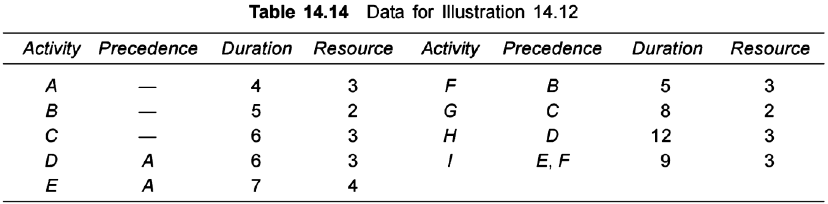
Example
Consider the project involving six activities shown in Table 14.14. The precedence and estimates of the activity times (in days) are shown in the table. Calculate ROT values for the activities and find the corresponding order.

Slide 68
Example
The calculations for the ROT values are as follows:
Activity A = minimum {3/4 + 3/6 + 3/12, 3/4 + 4/7 + 3/9} = 1.5
Activity B = 2/5 + 3/5 + 3/9 = 1.333
Activity C = 3/6 + 2/8 = 1. 25
Activity D = 3/6 + 3/12 = 0.75
Activity E = 4/7 + 3/9 = 0.905
Activity F = 3/5 + 3/9 = 0.9333
Activity G = 2/8 = 0.25
Activity H = 3/12 = 0.25
Activity I = 3/9 = 0.333.
The order is A-B-C-F-E-D-I-G-H. We can use the same sequence or change the order when resource and precedence constraints necessitate the change in order.

Slide 69
A Critique of PERT and CPM: advantages
Especially useful when scheduling and controlling large projects.
Straightforward concept and not mathematically complex.
Graphical networks help highlight relationships among project activities.
Critical path and slack time analyses help pinpoint activities that need to be closely watched.
Project documentation and graphs point out who is responsible for various activities.
Applicable to a wide variety of projects.
Useful in monitoring not only schedules but costs as well.
Source: Heizer, Render, & Munson (2020)

Slide 70
A Critique of PERT and CPM: limitations
Project activities have to be clearly defined, independent, and stable in their relationships.
Precedence relationships must be specified and networked together.
Time estimates tend to be subjective and are subject to fudging by managers who fear the dangers of being overly optimistic or not pessimistic enough.
There is the inherent danger of placing too much emphasis on the longest, or critical, path. Near-critical paths need to be monitored closely as well.
Source: Heizer, Render, & Munson (2020)

